Slide 1

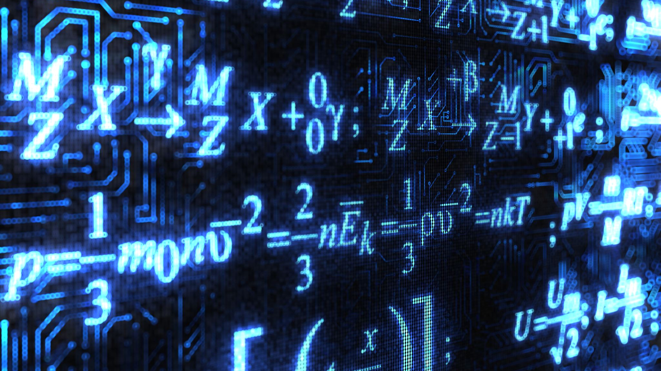
Algorithm complexity
Martzel P. Baste

Slide 2








LEARNING ACTIVATOR
easy to understand, code and debug
makes efficient use of the computer’s resources

Slide 3
Intended Learning outcomes
Explain the importance of program efficiency
Discuss the underlying concepts about space and time complexity in evaluating program performance

Slide 4
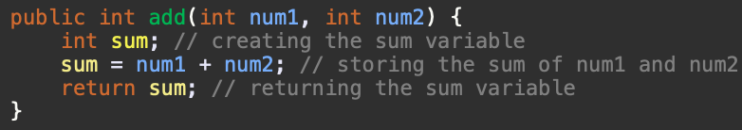



input
Declaration
Process
Output
  Take two integers
  Create sum variable
  store the result to sum variables
  return the "sum" variable
Input
Algorithm
Output

Slide 5





Data Structures
An Algorithm is just a method of doing something on a computer, while a Data Structure is a layout for memory that represents some sort of data.
~ Om Singh
Algorithms
Computer Science problems

Slide 6
The performance of an algorithm is measured based on the following properties :
Time Complexity
Space Complexity

Slide 7

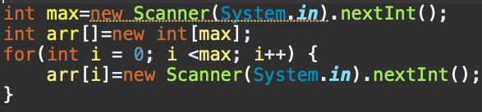

Space Complexity
256MB -> 10⁸ for normal array declaration
4MB -> 10⁶ for array in a function
is the amount of memory used by the algorithm (including the input values to the algorithm) to execute and produce the result.

Slide 8
For any algorithm memory may be used for the following:
Variables
Program Instruction
Execution

Slide 9
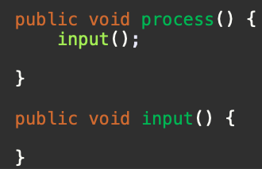







Space Complexity = Auxiliary Space + Input space
Memory Usage while Execution
Instruction Space
Environmental Stack
Data Space

Slide 10
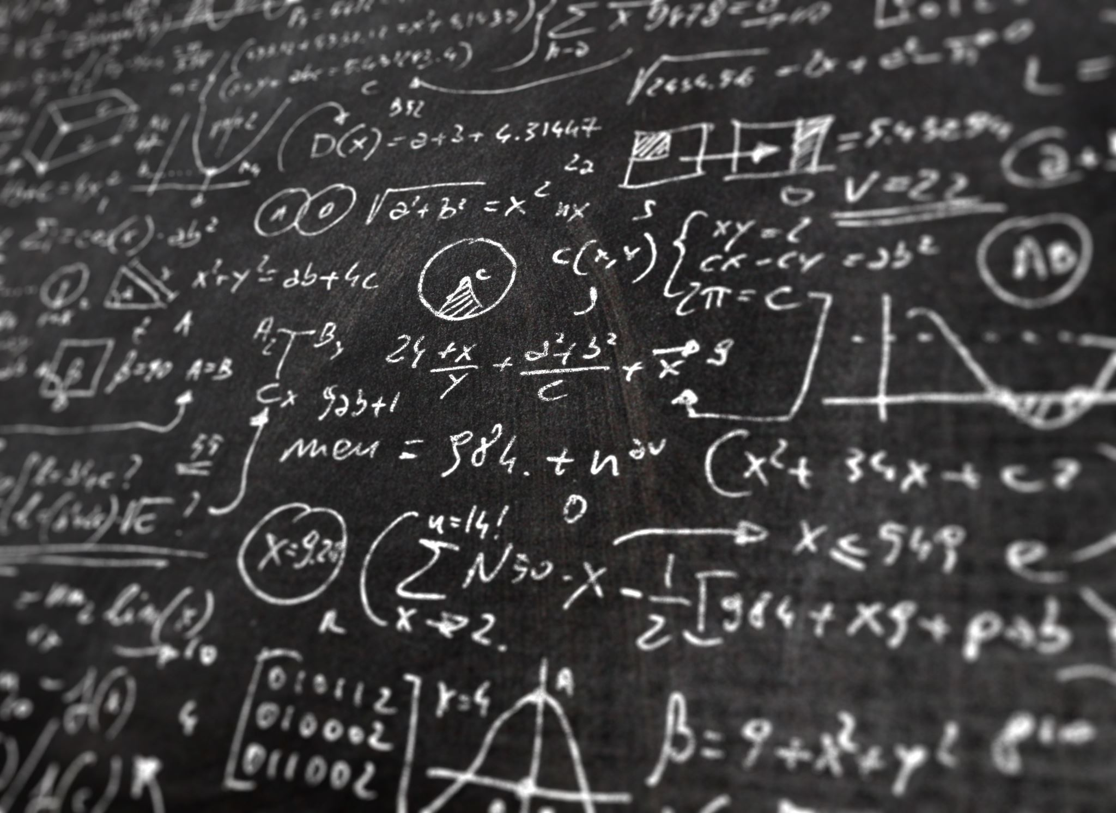
Calculating the Space Complexity
Data Type | Size
byte, boolean | 1 byte
short, char | 2 bytes
int | 4 bytes
long, double | 8 bytes

Slide 11
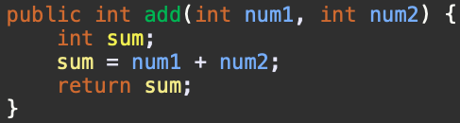


















Data Type | Size
byte, boolean | 1 byte
short, char | 2 bytes
int | 4 bytes
long, double | 8 bytes

Slide 12
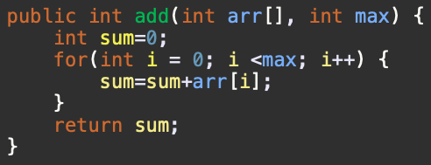














Data Type | Size
byte, boolean | 1 byte
short, char | 2 bytes
int | 4 bytes
long, double | 8 bytes

Slide 13

TIME complexity
Input Size: is defined as total number of elements present in the input.
For a given problem we characterize the input size N appropriately. For example:
Sorting problem
Graph Problem
Numerical Problem
Total number of item to be sorted
Total number of vertices and edges
Total number of bits needed to represent a number

Slide 14
TIME complexity
1 statement is 1 second
N statements is N seconds
run all the three algorithms on three different computers
run all the three algorithms on the same computer

Slide 15
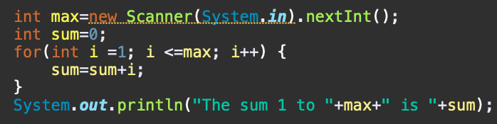

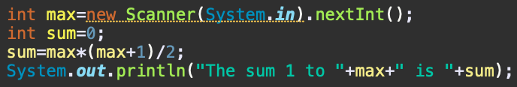




TIME complexity
Sum of first N natural numbers

Slide 16

In the first solution, the time complexity will be N atleast, there is an increase of time taken as the value of N increases.
While in the second, time complexity is constant, it will always give the result in 1 step because it is NOT dependent of N,
And since the algorithm's performance may vary with different types of input data, hence for an algorithm we usually use the worst-case Time complexity of an algorithm because that is the maximum time taken for any input size.

Slide 17
Summary
The efficiency of an algorithm is mainly defined by two factor; the Time Complexity and Space Complexity
While executing, algorithm uses memory space for three reasons:
  Instruction Space- It's the amount of memory used to save the compiled version of instructions.
  Environmental Stack -Sometimes an algorithm( or a function) may be called inside another algorithm.
  Data Space -Amount of space used by the variables and constants.
The time complexity is the number of operations an algorithm performs to complete its task with respect to input size.
The algorithm that performs the task in the smallest number of operations is considered the most efficient one.
Input Size: Input size is defined as total number of elements present in the input.

Slide 18














